Slide 2
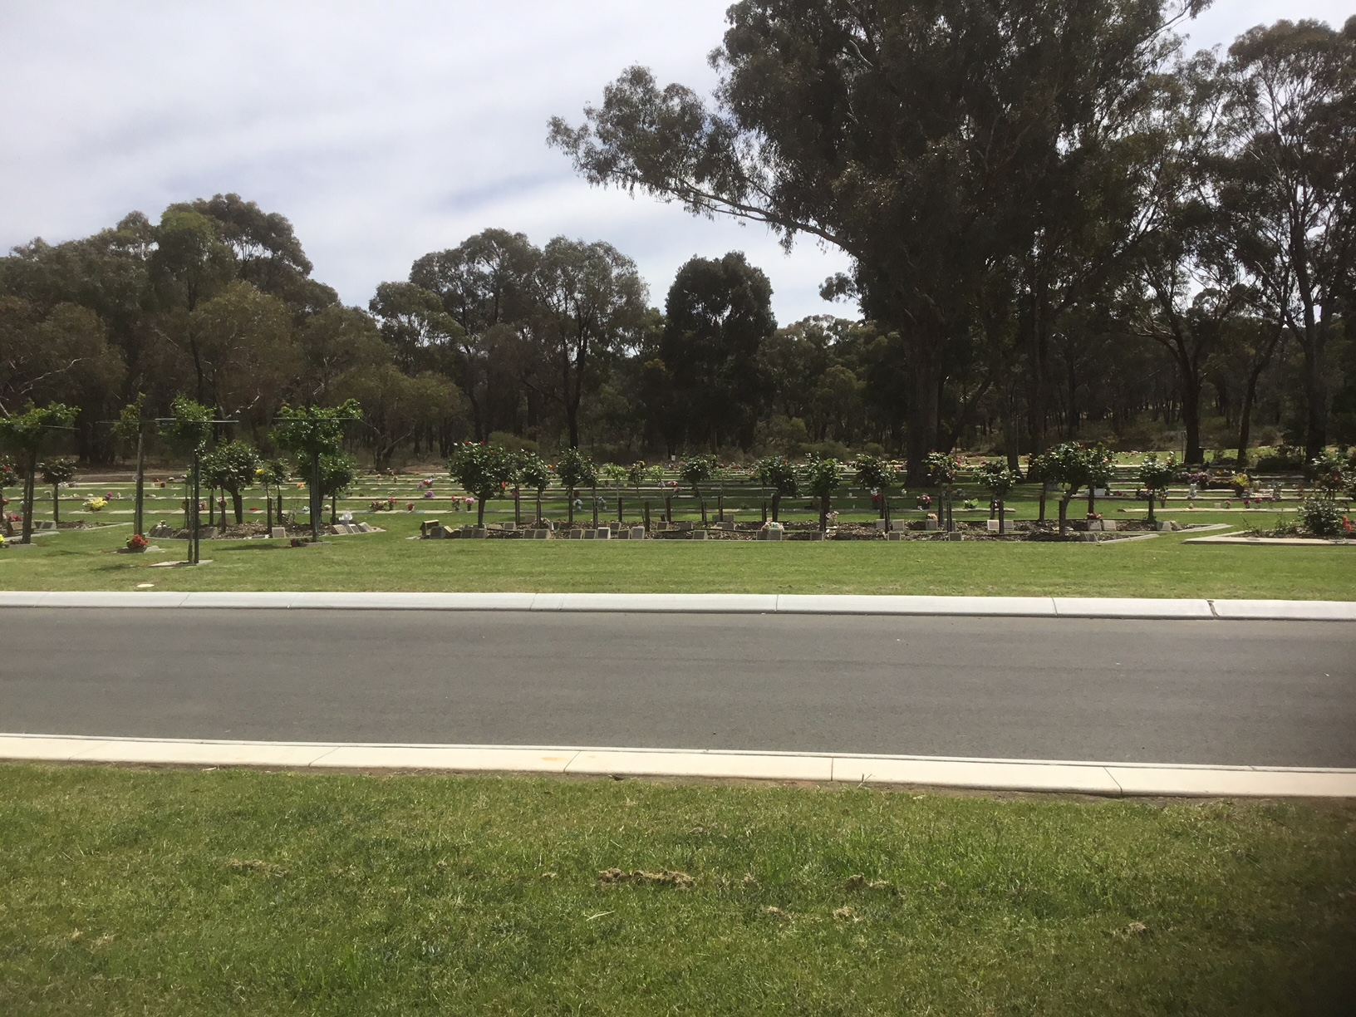
RPCV is a government entity established as one of the five Class A cemetery trusts under the Cemeteries and Crematoria Act 2003 in Victoria. RPCV is governed by trust members who have a policy and no operational role. They are appointed by the State Government and approved by the Governor-In-Council. RPCV reports directly to the Department of Health.

Slide 3
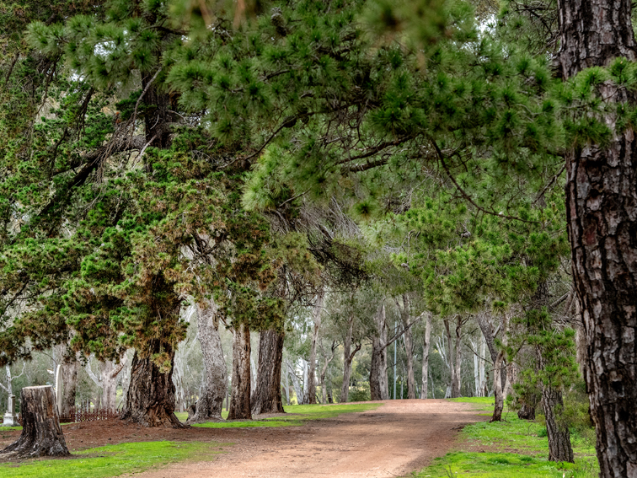
RPCV’S cemeteries are: Bendigo, Eaglehawk, Kangaroo Flat, White Hills, Pine Lodge, Kialla West, Axedale, Donnybrook, and Emu Creek RPCV manages on behalf of other cemetery trusts: the Axedale Catholic, Sunbury and Heathcote cemeteries. RPCV manages 125 ha. of land with over 110,000 interments, and over 50 km of roads. RPCV operates the Central Victorian Crematorium. The White Hills and Bendigo Cemeteries are heritage listed.

Slide 4
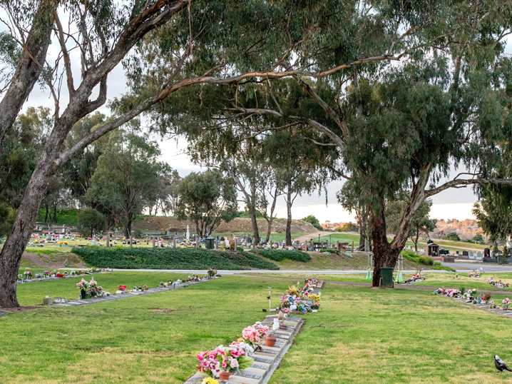
Each year RPCV completes: ~ 500 burials ~ 1300 cremations ~ 250 plaques for families RPCV manages ~ 350 permit applications for new monuments & ~ 6000 public contacts. RPCV works with 100 + different funeral directors. RPCV supports Class B Trusts across Victoria.

Slide 5
All public cemetery trusts in Victoria are self-funded.

Slide 6
Revenue raised by the cemetery trust through fees and charges is expected to: fund cemetery operational costs including ongoing perpetual maintenance obligations, cover repairs and replacement costs associated with facilities and equipment, and ensure adequate financial reserves for future operations.

Slide 7
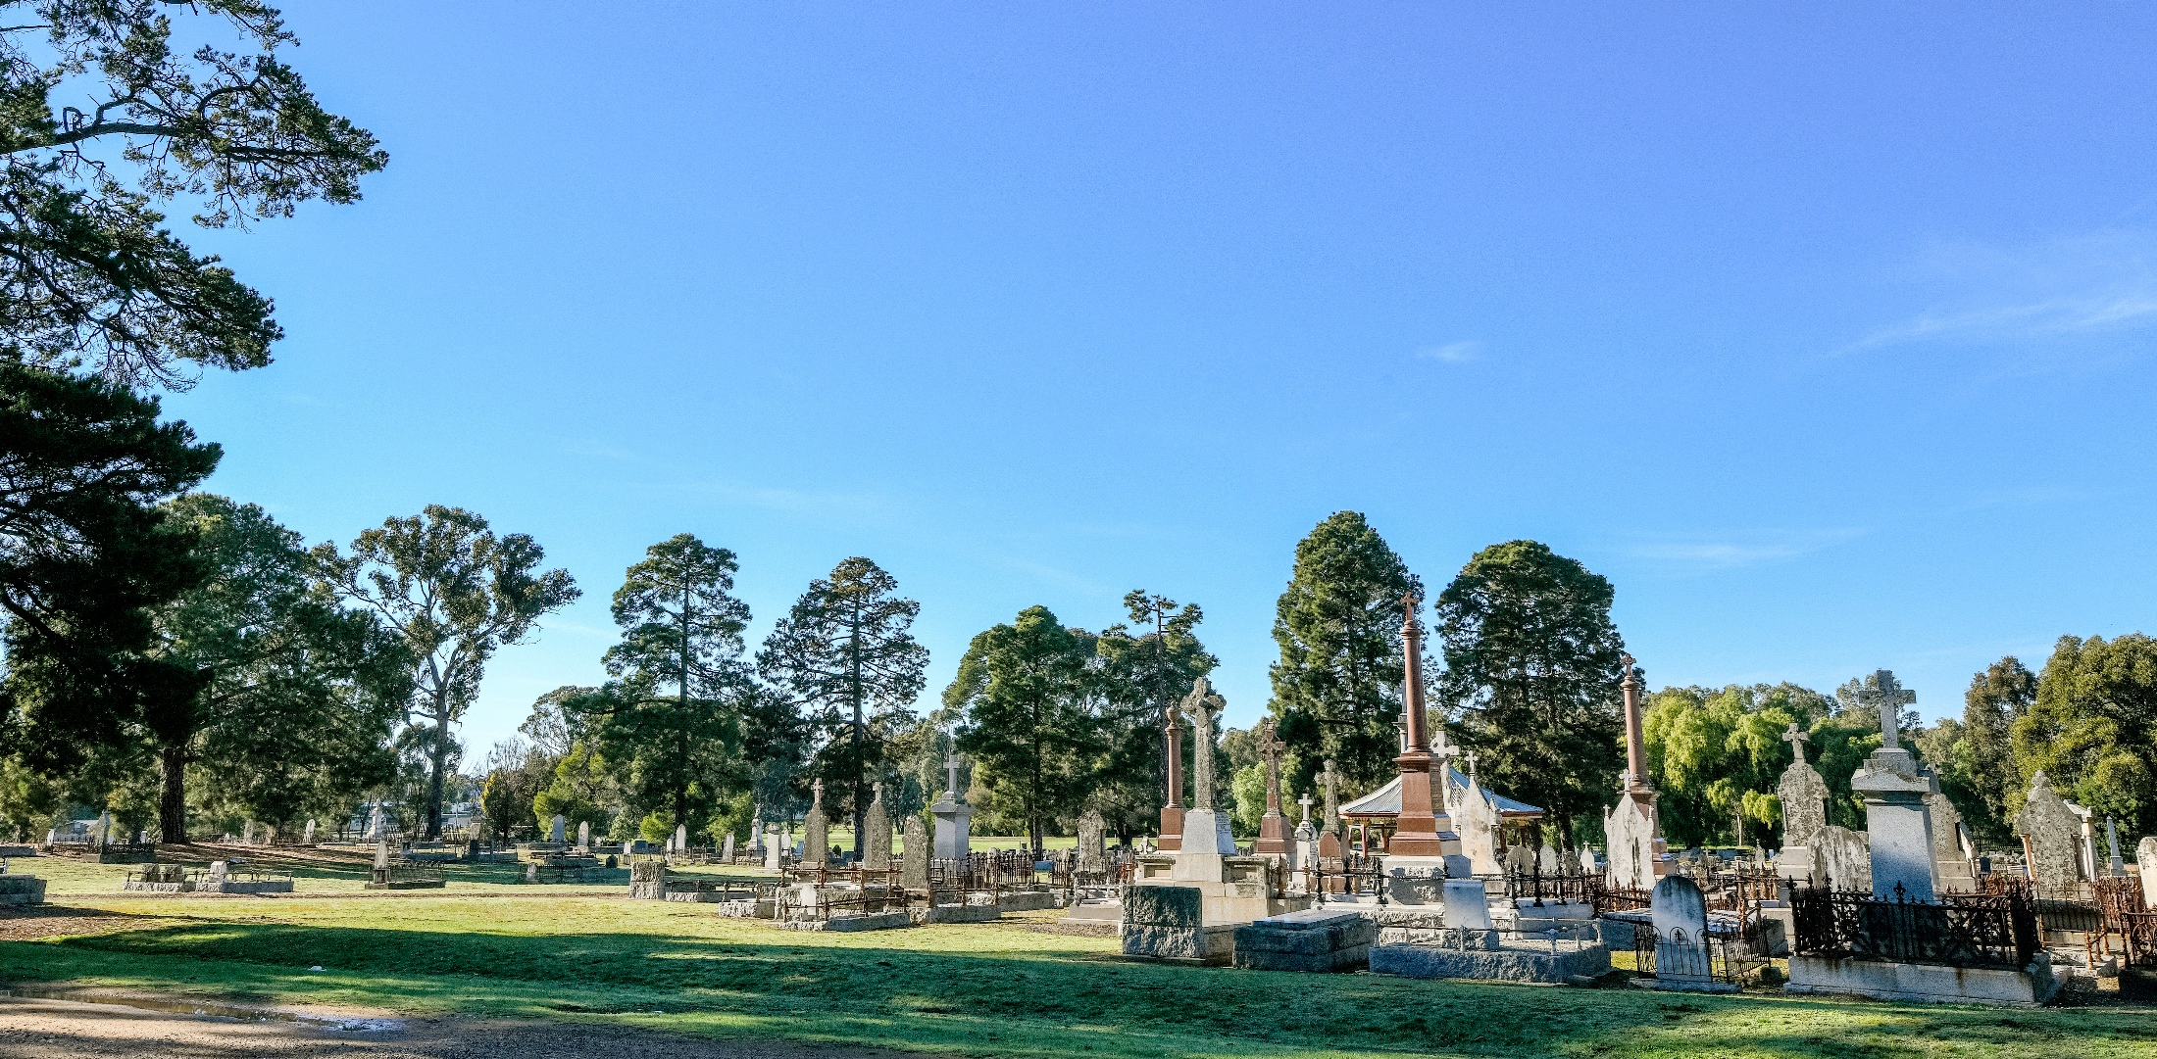
As RPCV is a not-for-profit organisation, any surplus funds are reinvested in the grounds and facilities.

Slide 8
RPCV can apply for specific capital project grants. Works funded by grants include: recycled water works at Eaglehawk, White Hills & Bendigo, fence restoration at White Hills, pergola restorations at Bendigo and White Hills chapel works (ongoing) at Bendigo solar power installation at Eaglehawk increased access to water at Pine Lodge, and tree planting across Bendigo district cemeteries.

Slide 9
For further information please contact us 1300 266 561 enquiries@rpcv.org.au

